Slide 1

CINEFY : MOVIE B0OKING APPLICATION
PRESENTED BY: - PARTH PARASHAR

Slide 2
Tech Stack
JAVA with Spring-boot framework
React JS
Docker
POSTGRE SQL

Slide 3
Features Included
Home page
Booking Page
Payment Page
About us Page

Slide 4
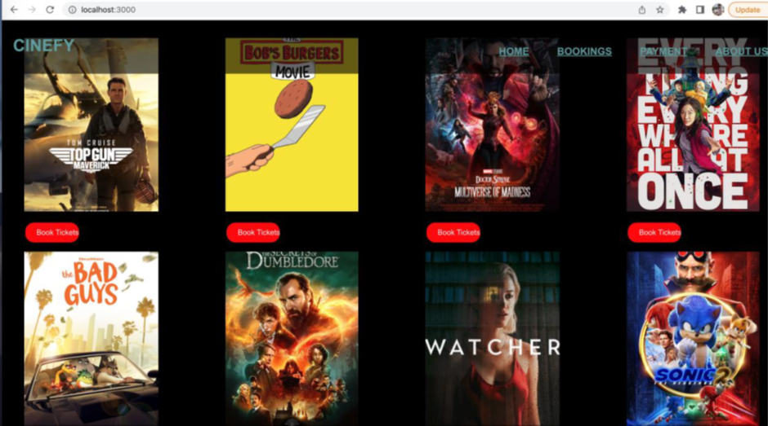
Home Page

Slide 5
Booking Page

Slide 6
Payment Page

Slide 7
About us Page

Slide 8
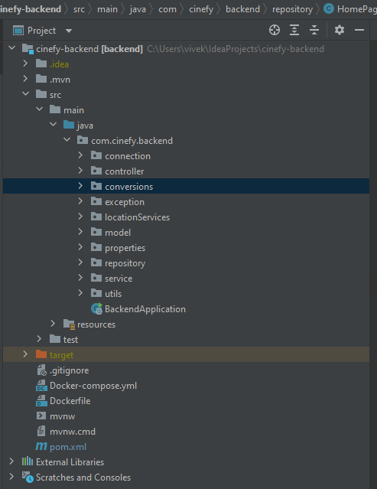
JAVA Backend Specifications

Slide 9
Frontend Specifications

Slide 11
Future Scope
Addition of more features
Addition of proper microservices architecture

Slide 12
THANK YOU

